Slide 1
Linux Containers On Azure
Delivering modern cloud native applications with open source technologies on Azure

Slide 2
Who am I?
Bruno Medina
Bolanos Cacho
SR Software Developer Engineer
Commercial Software Engineering (CSE)
@brusmx

Slide 3
Agenda
Time
Topic
8:30 – 9:00
Breakfast and get settled
9:00 – 9:45
Cloud Native Applications, Containers, and Docker
9:45 – 11:00
HANDS-ON: Labs 1, 2
11:00 – 11:45
Kubernetes Overview, Azure Kubernetes Service, Kubernetes Concepts
11:45
Working Lunch
11:45 – 1:00
HANDS-ON: Labs 3, 4, 5
1:00 – 1:15
Azure Containers Deep Dive: ACI, Open Service Broker, and more. Operations / Management Concepts
1:15– 2:15
HANDS-ON: Labs 6, 7
2:15 – 2:45
Managing Storage and State, and utilizing Azure PaaS (CosmosDB)
2:45 – 4:00
HANDS-ON: Labs 8, 9, 10
2:15 – 2:45
Q&A, wrap-up, and next steps

Slide 4



Table of contents
Azure Container Registry
Open source community
Azure Kubernetes Service (AKS)
Release automation tools
Containers 101
Getting started
Azure container technology
Open Service Broker for Azure (OSBA)
Customer success stories
Container orchestration
Azure Container Instances (ACI)

Slide 5
Containers 101
Azure Container Registry
Open source community
Azure Kubernetes Service (AKS)
Release automation tools
Containers 101
Getting started
Azure container technology
Open Service Broker for Azure (OSBA)
Customer success stories
Container orchestration
Azure Container Instances (ACI)

Slide 6
Cloud native applications
“Unlimited” Scale
Global reach
Rapid innovation -> time to market
Notes:
IE – We don’t build cloud native, distributed apps just because it is “cool” and new. The business benefits are key

Slide 7
From traditional app to modern app
APP
Existing Application
Modern Infrastructure
rehost as VMs or refresh to modern container platform.
Containerize Applications
Re-architect apps for scale with containers.
Modern Microservices
Add new services or start peeling off services from monolithic code.
On-Premises
Infrastructure Platform
IaaS
Infrastructure Platform
“lift & shift”
Containers
Container Platform
PaaS
Application Platform
Serverless

Slide 8
What we hear from developers
I need to create applications at a competitive rate without worrying about IT
New applications run smoothly on my machine but malfunction on traditional IT servers
My productivity and application innovation become suspended when I have to wait on IT

Slide 9
What we hear from IT
I need to manage servers and maintain compliance with little disruption
I’m unsure of how to integrate unfamiliar applications, and I require help from developers
I’m unable to focus on both server protection and application compliance

Slide 10
What is a container?
Containers = operating system virtualization
Traditional virtual machines = hardware virtualization
OS
Application
VM
VM
VM
Applications
Container
Container
Container
App
App
App
Kernel
OS
OS
OS
OS
Hardware
Hardware

Slide 11
Virtualization versus containerization
Virtual machine
Container
Application XYZ
Application
App dependencies
Dependencies
Guest OS
C
C
C
C
C
VM
VM
VM
VM
VM
VM
Dependency 1
Dependency 2
Hypervisor 2
Docker Engine
Hypervisor 1
Host OS
Host OS
Hardware
Hardware
Hardware
Type 1
Type 2
Virtualization
Containerization

Slide 12
The container advantage
Traditional virtualized environment
VM
VM
Low utilization of container resources
Application
Con.
Con.
Application
Containerization of applications and their dependencies
Con.
Con.
Hypervisor 2
Host OS
Hardware

Slide 13
The container advantage
Containerized environment
Migrate containers and their dependencies to underutilized VMs for improved density and isolation
VM
VM
Con.
Con.
Decommission unused resources for efficiency gains and cost savings
Con.
Con.
Docker Engine
Host OS
Hardware

Slide 14
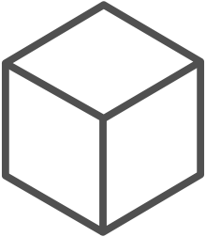
The container advantage
Fast iteration
Agile delivery
Immutability
Cost savings
Efficient deployment
Elastic bursting
For developers
For IT

Slide 15
Demo
Running containers locally

Slide 16


Containers are gaining momentum
Does your organization currently use container technologies?¹
23%
My org. is evaluating container technologies
Yes, my org. currently uses container technologies
No, my org. is not using container technologies
Not sure
Not applicable
Larger companies are leading adoption.²
42%
~60%
25%
7%
Nearly 60% percent of organizations running 500 or more hosts are classiﬁed as container dabblers or adopters.
2%
The average company QUINTUPLES its container usage within 9 months.¹
Container hosts often run SEVEN containers at a time.¹
Containers churn 9 times FASTER than VMs.¹
5x
7x
9x
Source:
1: Datadog: 8 Surprising Facts About Real Docker Adoption; 2: DZone: The DZone Guide to Deploying and Orchestrating Containers

Slide 17


Industry analysts agree
“By 2020, more than 50% of enterprises will run mission-critical, containerized cloud-native applications in production, up from less than 5% today.”

Slide 18
¡Challenge time!
Running containers locally

Slide 19

Container orchestration
Azure Container Registry
Open source community
Azure Kubernetes Service (AKS)
Release automation tools
Containers 101
Getting started
Azure container technology
Open Service Broker for Azure (OSBA)
Customer success stories
Container orchestration
Azure Container Instances (ACI)

Slide 20
The elements of orchestration
Scheduling
Affinity/anti-affinity
Health monitoring
Failover
Scaling
Networking
Service discovery
Coordinated app upgrades

Slide 21
Service Fabric

Slide 22
Container Management at Scale
Cluster Management: deploy and manage cluster resources
Scheduling: where containers run
Lifecycle & Health: keep containers running despite failure
Service Discovery & Load Balancing: where are my containers and how to connect
Security: control access to cluster resources and protect secrets
Scaling: make sets of containers elastic in number
Image repository: centralized, secure Docker container images
Continuous Delivery: CI/CD pipeline and workflow
Logging & Monitoring: track what’s happening in containers and cluster
Storage volumes: persistent data for containers
Notes:
“Container-centric infrastructure”
Additionally: configuration management, debugging/introspection, identity and authorization

Slide 24
Kubernetes: the de-facto orchestrator
Portable
Public, private, hybrid, multi-cloud
Extensible
Modular, pluggable, hookable, composable
Self-healing
Auto-placement, auto-restart, auto-replication, auto-scaling

Slide 25
Kubernetes: empowering you to do more
Deploy your applications quickly and predictably
Scale your applications on the fly
Roll out new features seamlessly
Limit hardware usage to required resources only

Slide 26

“Distributed apps are sufficiently complicated that they need to be flown by the instruments”
Notes:
This is meant to highlight the need for advanced tooling and orchestration for highly complex distributed apps

Slide 27
Azure container technology
Azure Container Registry
Open source community
Azure Kubernetes Service (AKS)
Release automation tools
Containers 101
Getting started
Azure container technology
Open Service Broker for Azure (OSBA)
Customer success stories
Container orchestration
Azure Container Instances (ACI)

Slide 28
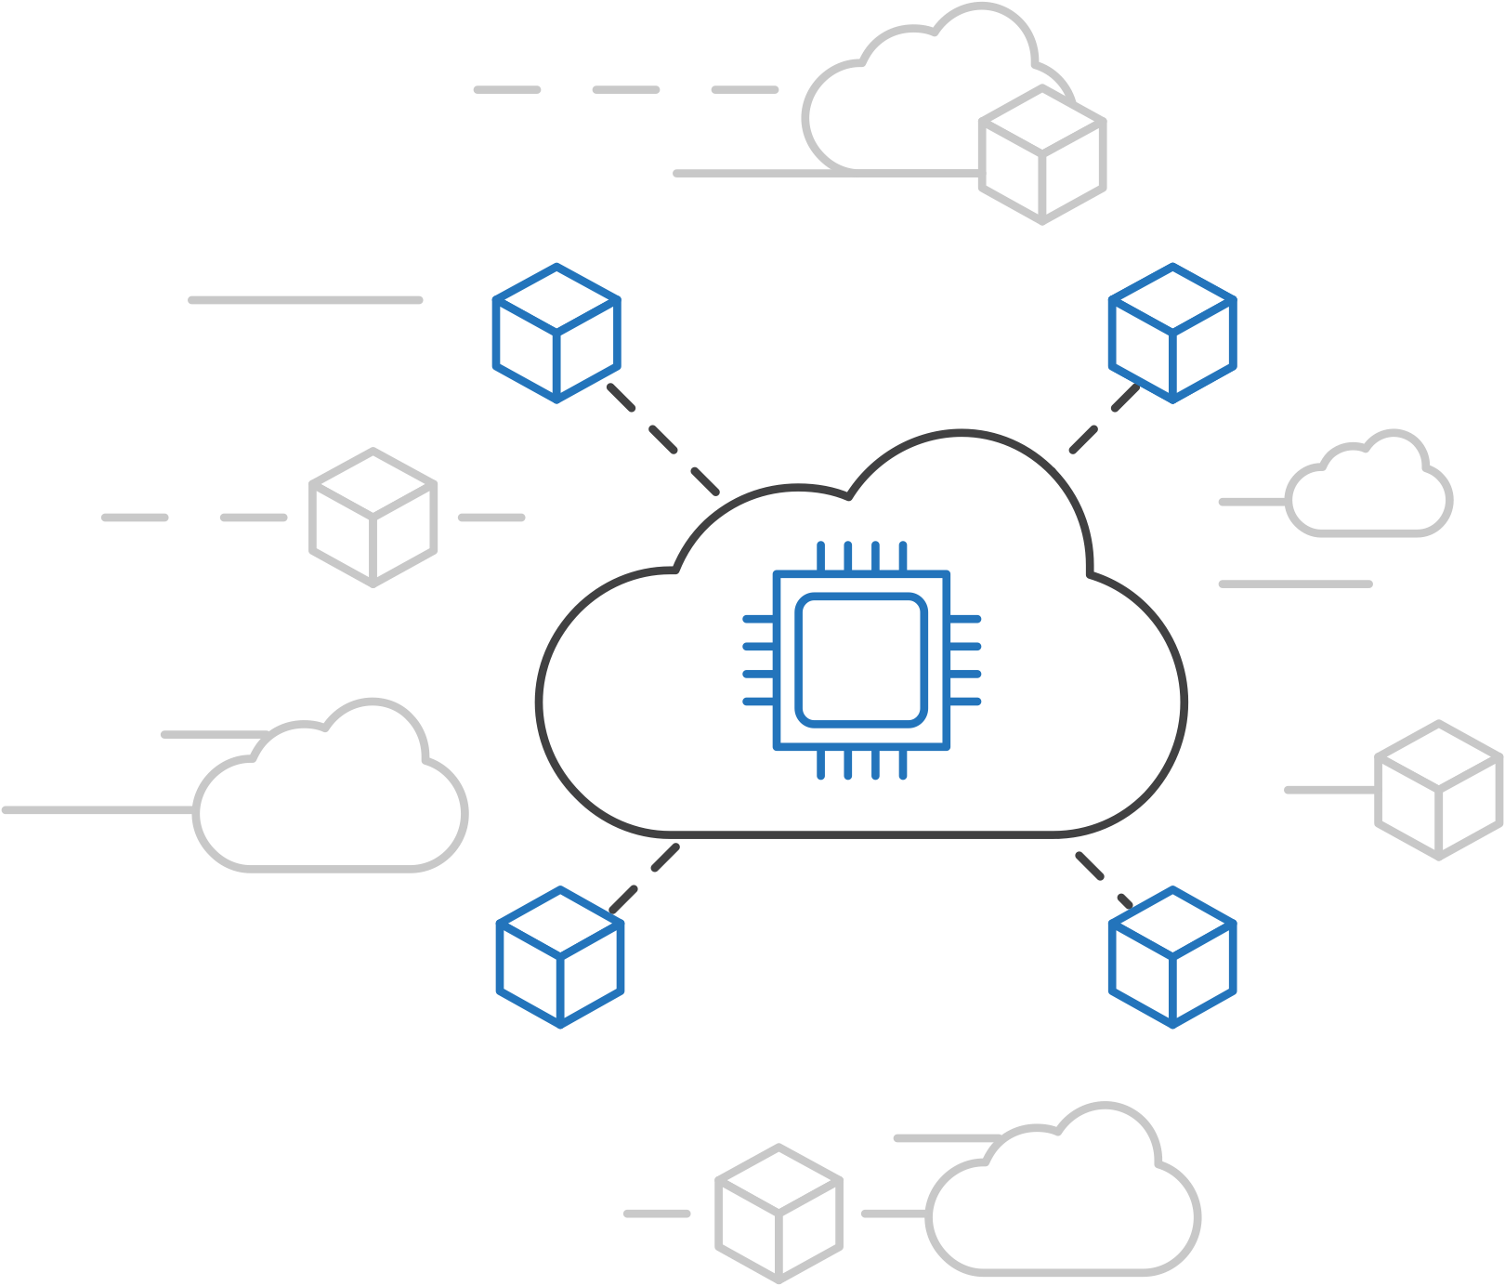
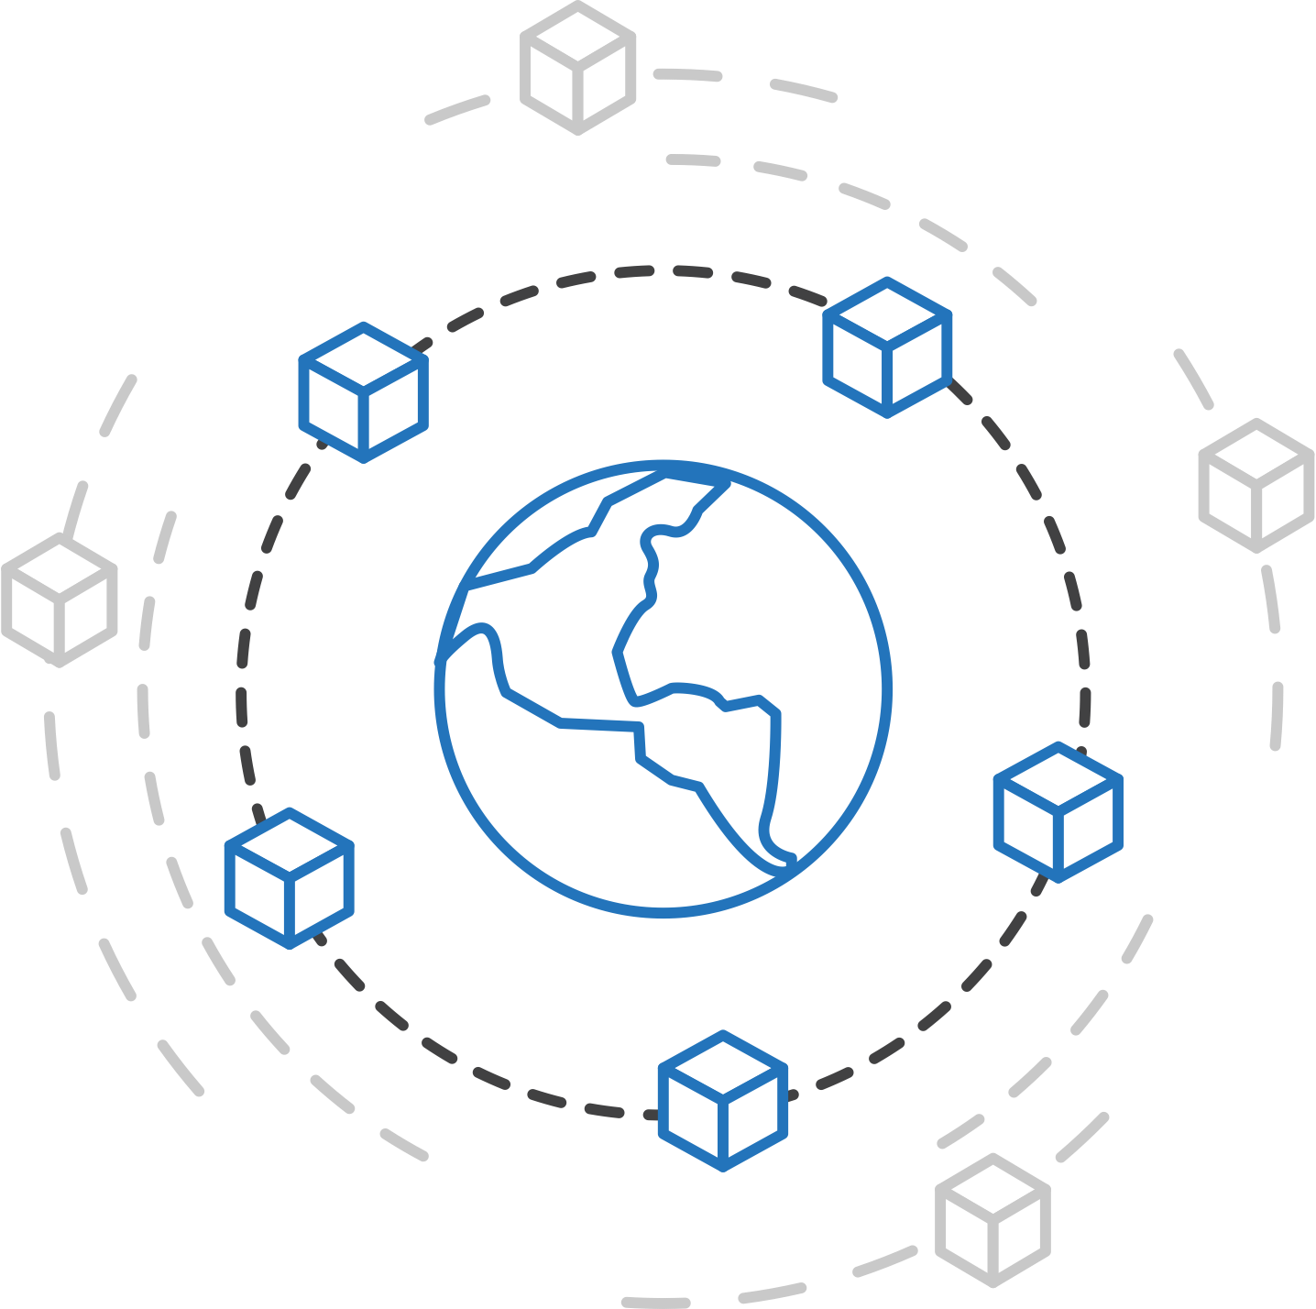
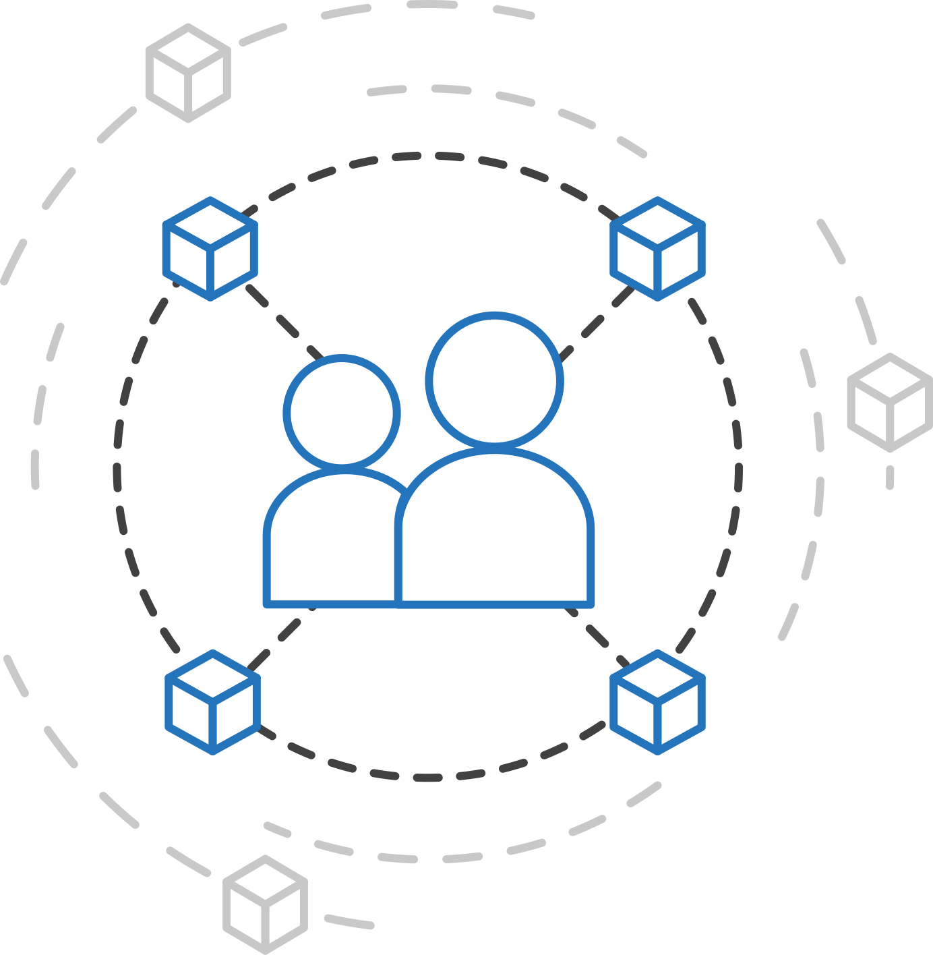
Azure container strategy
Embrace containers as ubiquitous
Support containers across the compute portfolio
Democratize container technology

Slide 29



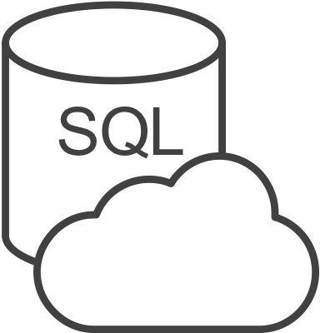


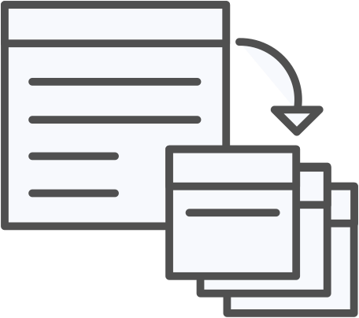


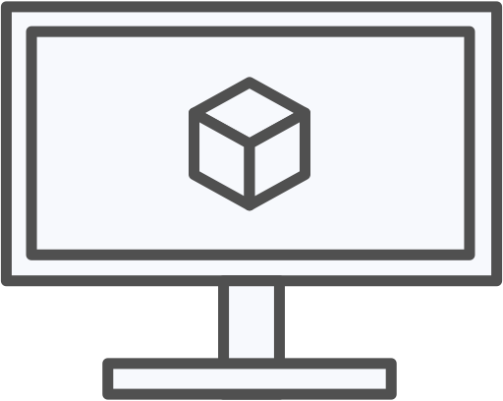
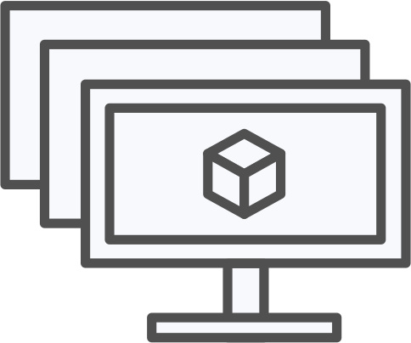
Azure container ecosystem
OSBA
App Service
Azure Container Registry (ACR)
Partner services
Azure services
PaaS
OpenShift
SQL Database
Azure Kubernetes Service (AKS)
Service Fabric
Batch
Pivotal Cloud Foundry
Redis Cache
ACS Engine
Docker Enterprise Edition
CosmosDB
Virtual kubelet
Mesosphere DC/OS
And more!
Azure Container Instances (ACI)
Azure Virtual Machines
Virtual Machine Scale Sets (VMSS)
Azure
IaaS

Slide 30
Azure Kubernetes Service (AKS)
Azure Container Registry
Open source community
Azure Kubernetes Service (AKS)
Release automation tools
Containers 101
Getting started
Azure container technology
Open Service Broker for Azure (OSBA)
Customer success stories
Container orchestration
Azure Container Instances (ACI)

Slide 31

Azure Kubernetes Service (AKS)
Azure Kubernetes Service (AKS)
Azure Container Instances (ACI)
OSBA
App Service
Azure Container Registry (ACR)
Partner services
Azure services
PaaS
Azure Container Registry
OpenShift
SQL Database
Azure Kubernetes Service (AKS)
Service Fabric
Batch
Pivotal Cloud Foundry
Redis Cache
ACS Engine
Open Service Broker API (OSBA)
Docker Enterprise Edition
CosmosDB
Virtual kubelet
Mesosphere DC/OS
And more!
Azure Container Instances (ACI)
Azure Virtual Machines
Virtual Machine Scale Sets (VMSS)
Release Automation Tools
Azure
IaaS

Slide 32
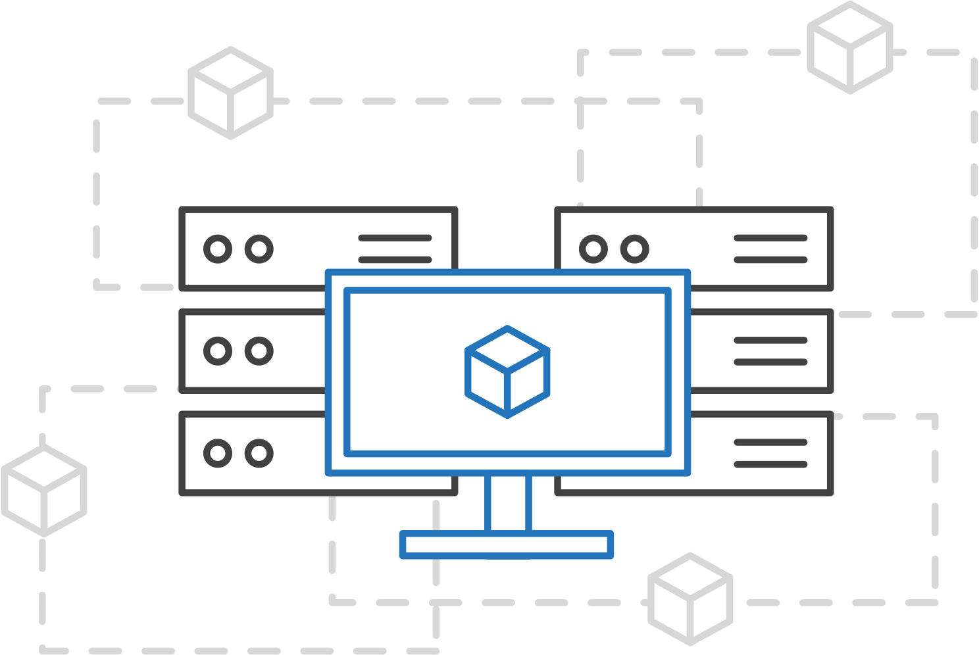
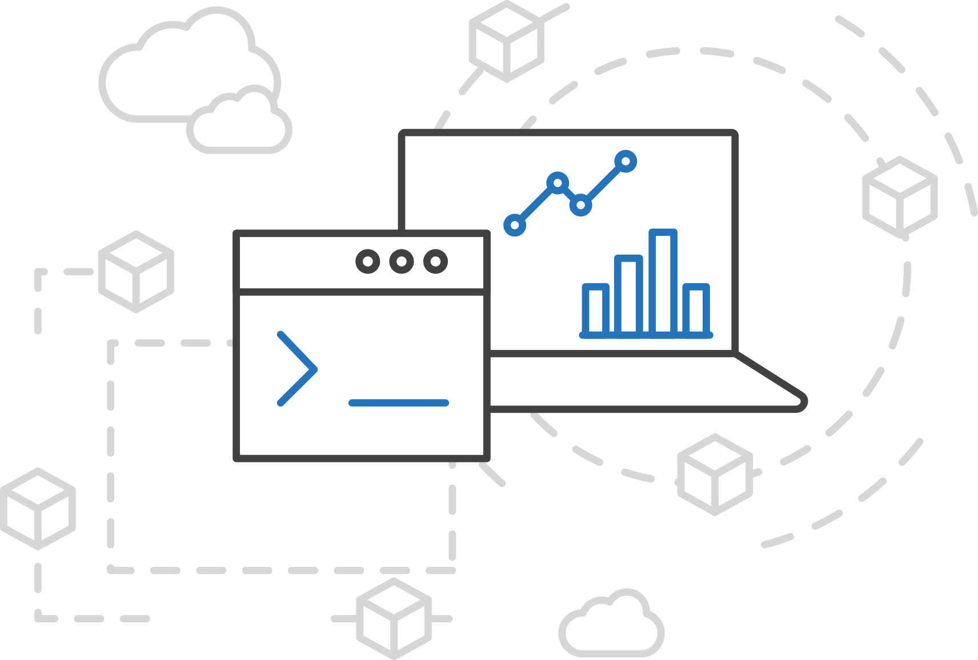
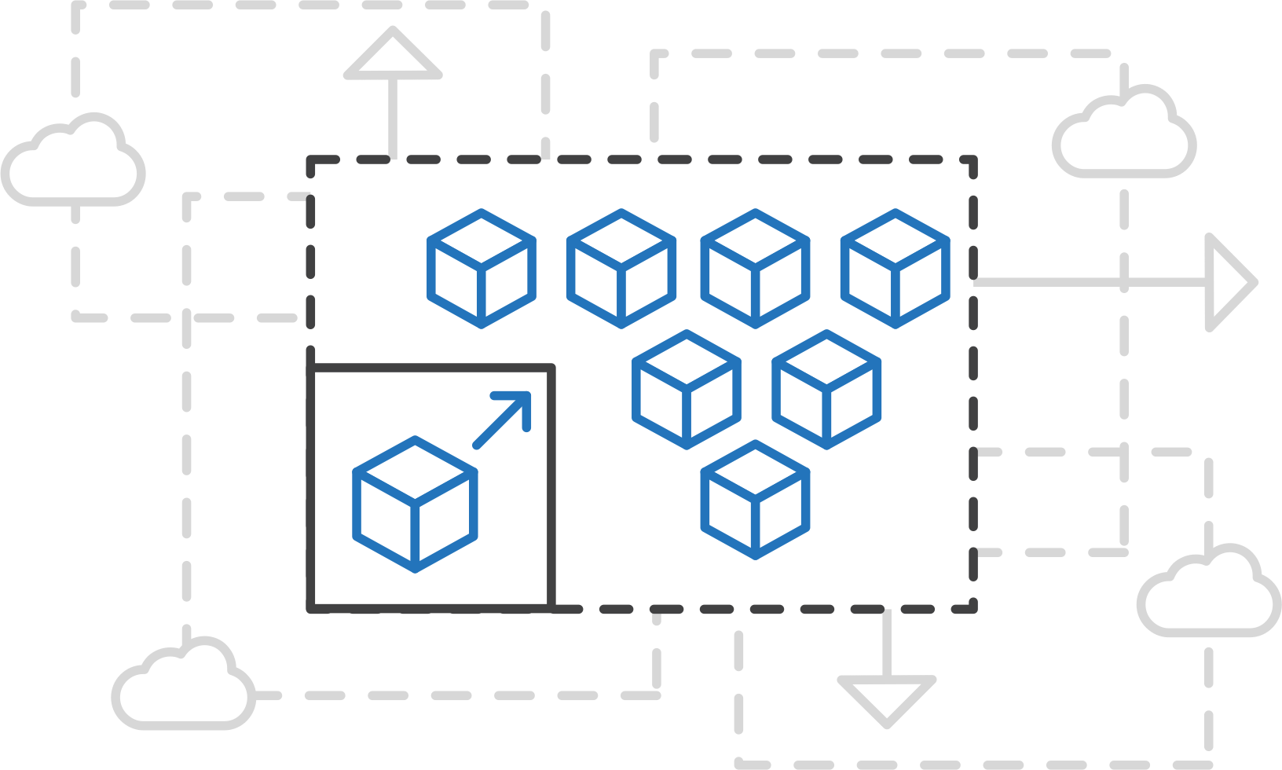
Azure Kubernetes Service (AKS)
Azure Kubernetes Service (AKS)
Simplify the deployment, management, and operations of Kubernetes
Azure Container Instances (ACI)
Azure Container Registry
Open Service Broker API (OSBA)
Focus on your containers not the infrastructure
Work how you want with open-source APIs
Scale and run applications with confidence
Release Automation Tools

Slide 33
Azure Kubernetes Service (AKS)
Azure Kubernetes Service (AKS)
A fully managed Kubernetes cluster
Azure Container Instances (ACI)
Managed control pane
Automated upgrades, patches
Easy cluster scaling
Self-healing
Cost savings
Azure Container Registry
Managed
Application architect
Applications
Open Service Broker API (OSBA)
Operations
Kubernetes
Infrastructure architect
Docker
Release Automation Tools
Azure infrastructure services

Slide 34
¡Let’s create a K8s cluster!
Running containers on Azure

Slide 35
Azure Kubernetes Service (AKS)
Azure Kubernetes Service (AKS)
Get started easily
Azure Container Instances (ACI)
$ az aks create -g myResourceGroup -n myCluster --generate-ssh-keys
\ Running ..
$ az aks install-cli
Downloading client to /usr/local/bin/kubectl ..
$ az aks get-credentials -g myResourceGroup -n myCluster
Merged "myCluster" as current context ..
$ kubectl get nodes
NAME STATUS AGE VERSION
aks-mycluster-36851231-0 Ready 4m v1.8.1
aks-mycluster-36851231-1 Ready 4m v1.8.1
aks-mycluster-36851231-2 Ready 4m v1.8.1
Azure Container Registry
Open Service Broker API (OSBA)
Release Automation Tools

Slide 36
Azure Kubernetes Service (AKS)
Azure Kubernetes Service (AKS)
Manage an AKS cluster
Azure Container Instances (ACI)
$ az aks list –o table
Name Location ResourceGroup KubernetesRelease ProvisioningState
------------------ ---------- -------------- ------------------- -------------------
myCluster westus2 myResourceGroup 1.7.7 Succeeded
$ az aks upgrade -g myResourceGroup -n myCluster –-kubernetes-version 1.8.1
\ Running ..
$ kubectl get nodes
NAME STATUS AGE VERSION
aks-mycluster-36851231-0 Ready 12m v1.8.1
aks-mycluster-36851231-1 Ready 8m v1.8.1
aks-mycluster-36851231-2 Ready 3m v1.8.1
$ az aks scale -g myResourceGroup -n myCluster --agent-count 10
\ Running ..
Azure Container Registry
Open Service Broker API (OSBA)
Release Automation Tools

Slide 37
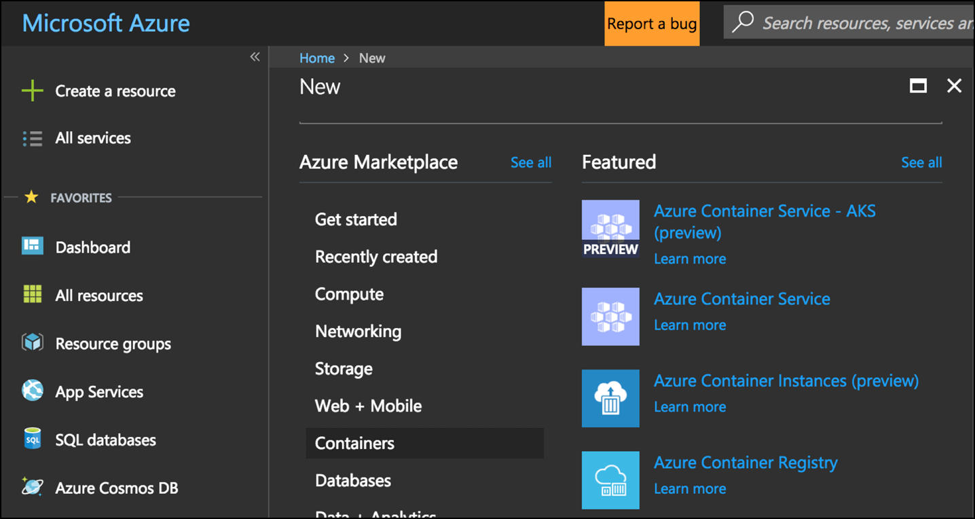
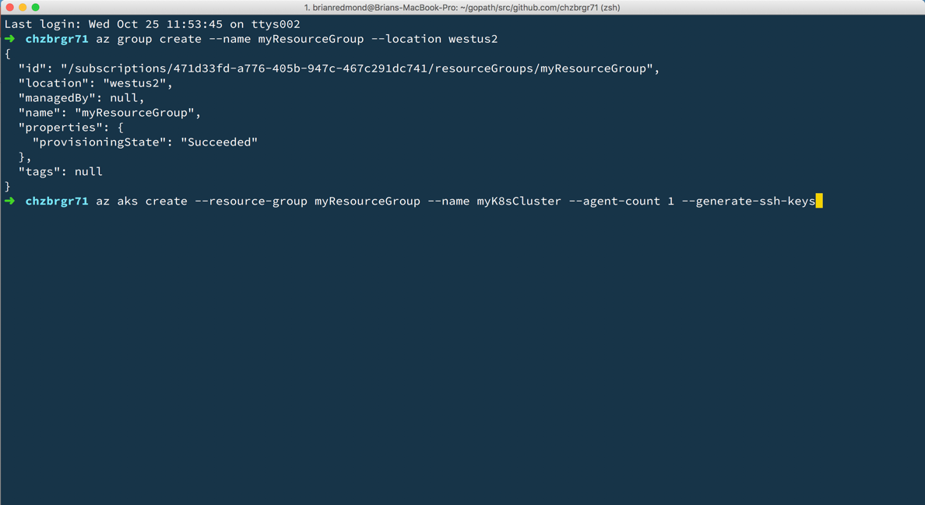
Azure Kubernetes Service (AKS)
Azure Kubernetes Service (AKS)
Create AKS via Portal, Azure CLI, or ARM template
Azure Container Instances (ACI)
Azure Container Registry
Open Service Broker API (OSBA)
Release Automation Tools

Slide 38
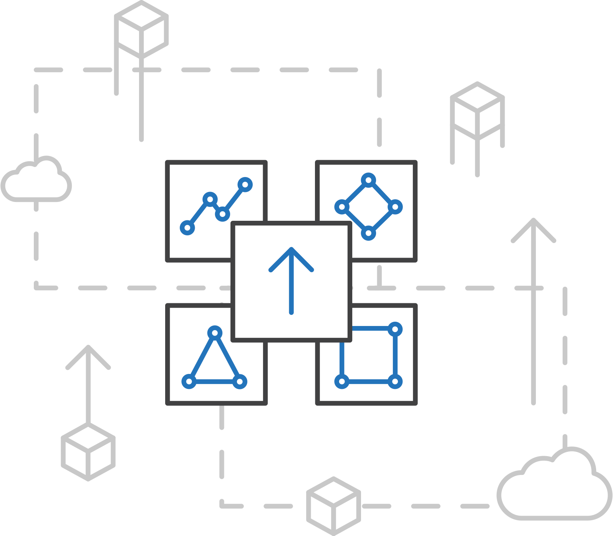
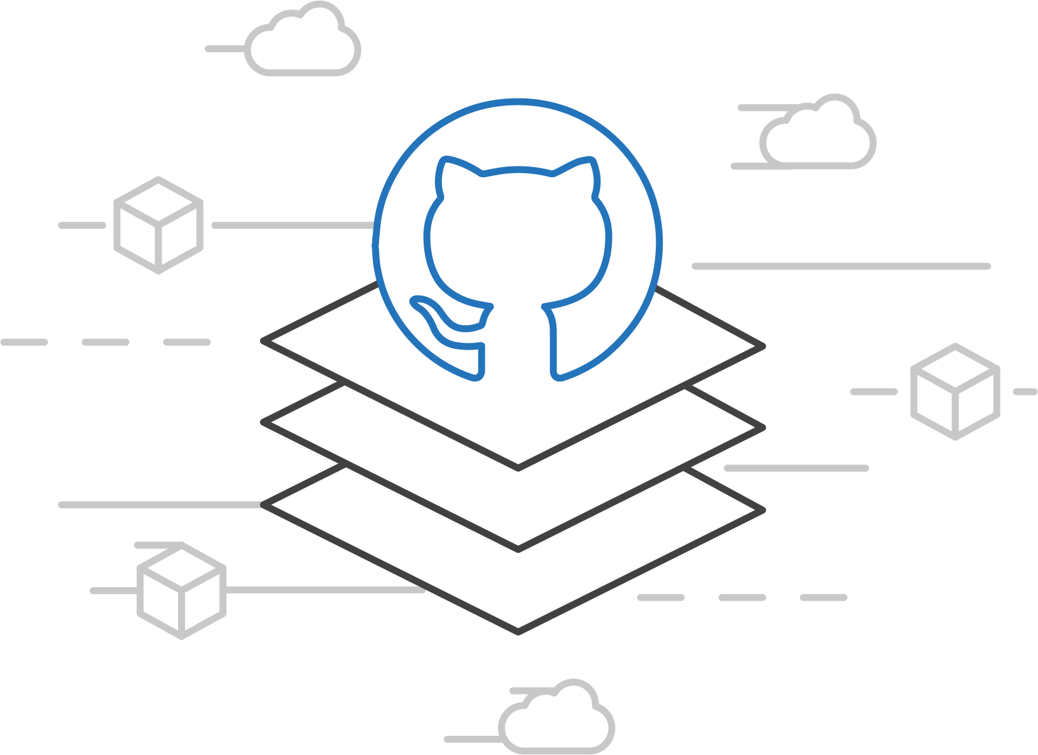
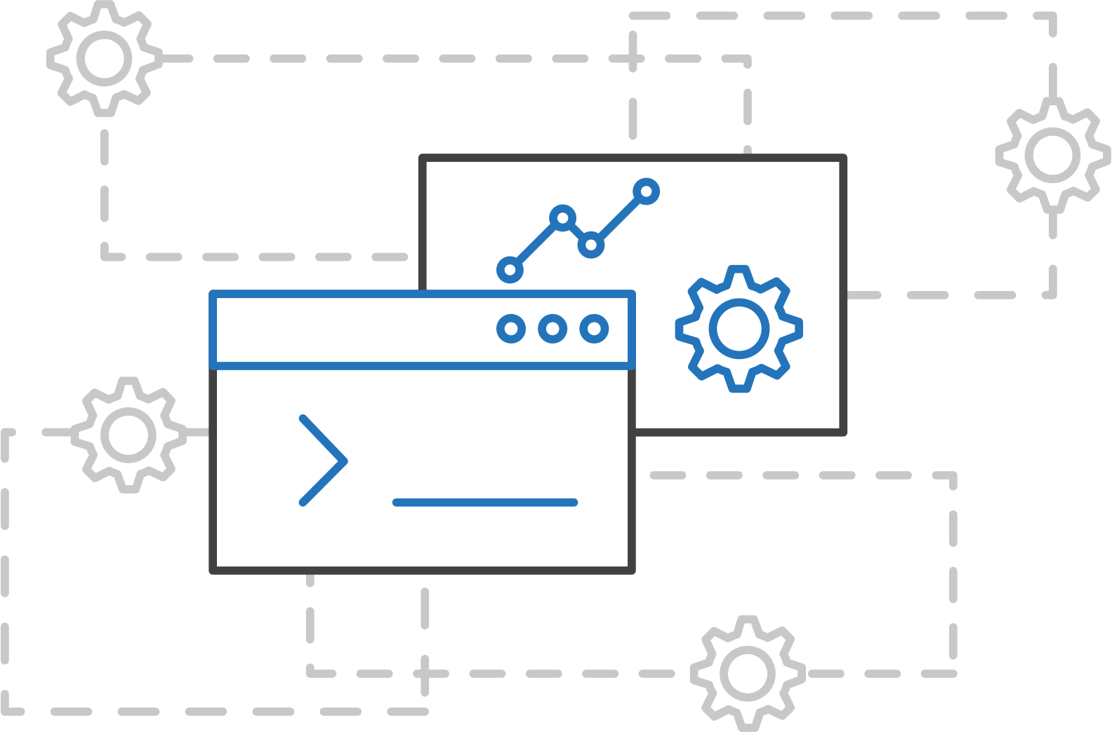
ACS Engine
Azure Kubernetes Service (AKS)
Customized Kubernetes on Azure
Azure Container Instances (ACI)
Azure Container Registry
Open Service Broker API (OSBA)
A proving ground for new features
Enables custom deployments
Available on GitHub
Release Automation Tools

Slide 39
Azure Container Instances (ACI)
Azure Container Registry
Open source community
Azure Kubernetes Service (AKS)
Release automation tools
Containers 101
Getting started
Azure container technology
Open Service Broker for Azure (OSBA)
Customer success stories
Container orchestration
Azure Container Instances (ACI)

Slide 40
Azure Container Instances (ACI)
Azure Kubernetes Service (AKS)
PREVIEW
Azure Container Instances (ACI)
OSBA
App Service
Azure Container Registry (ACR)
Partner services
Azure services
PaaS
Azure Container Registry
OpenShift
SQL Database
Azure Kubernetes Service (AKS)
Service Fabric
Batch
Pivotal Cloud Foundry
Redis Cache
ACS Engine
Open Service Broker API (OSBA)
Docker Enterprise Edition
CosmosDB
Virtual kubelet
Mesosphere DC/OS
And more!
Azure Container Instances (ACI)
Azure Virtual Machines
Virtual Machine Scale Sets (VMSS)
Release Automation Tools
Azure
IaaS

Slide 41
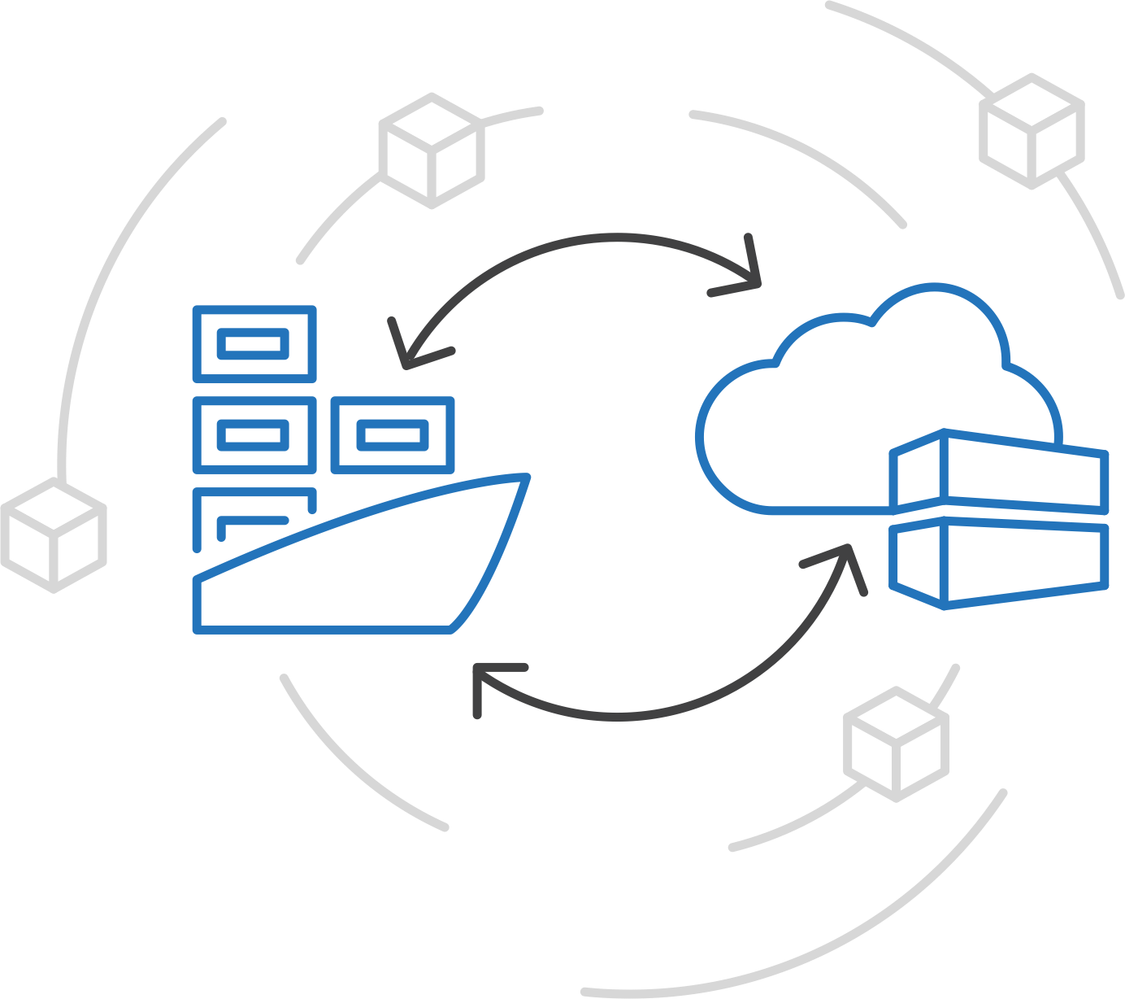
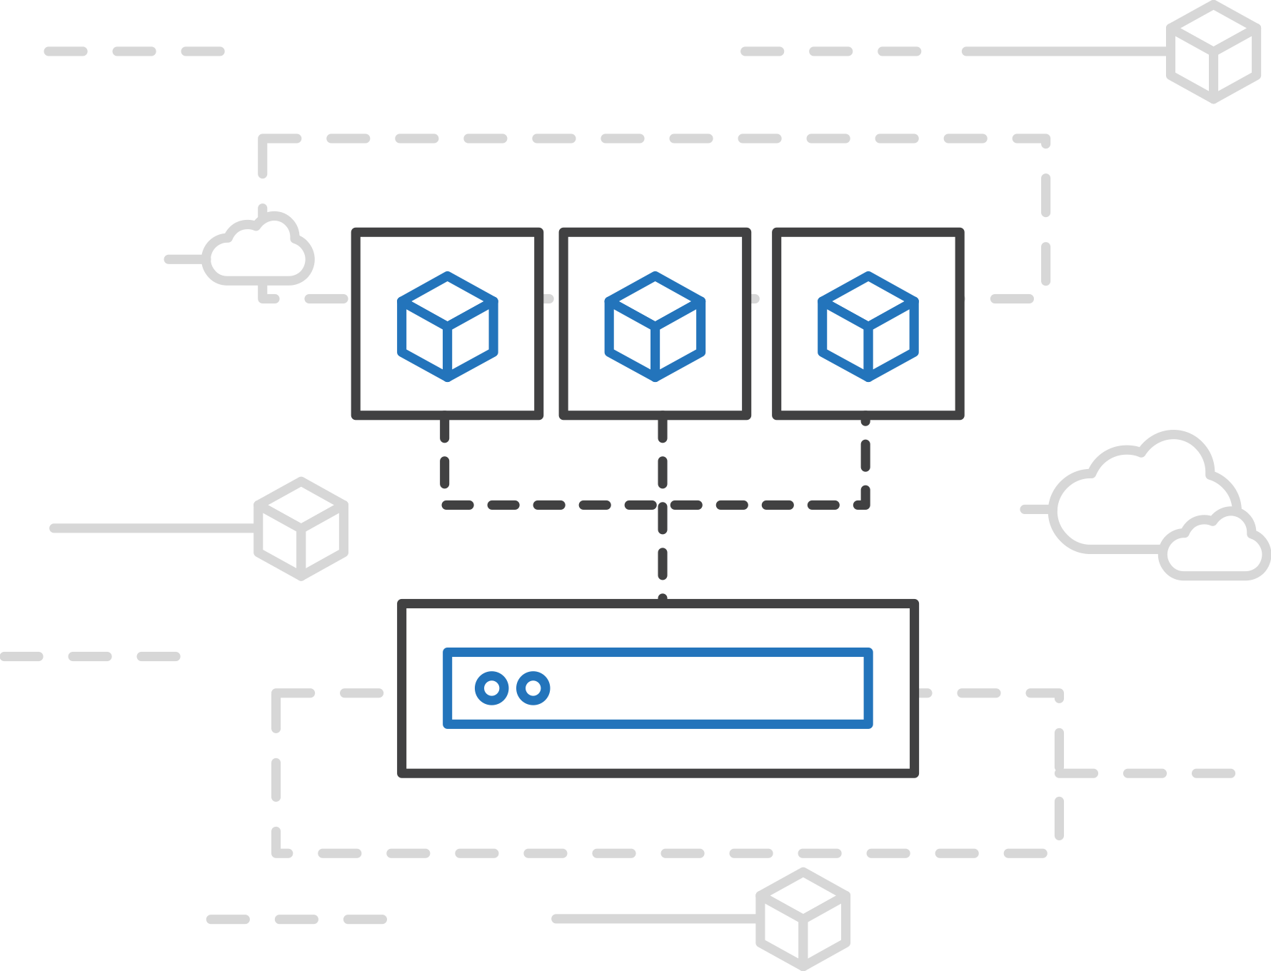
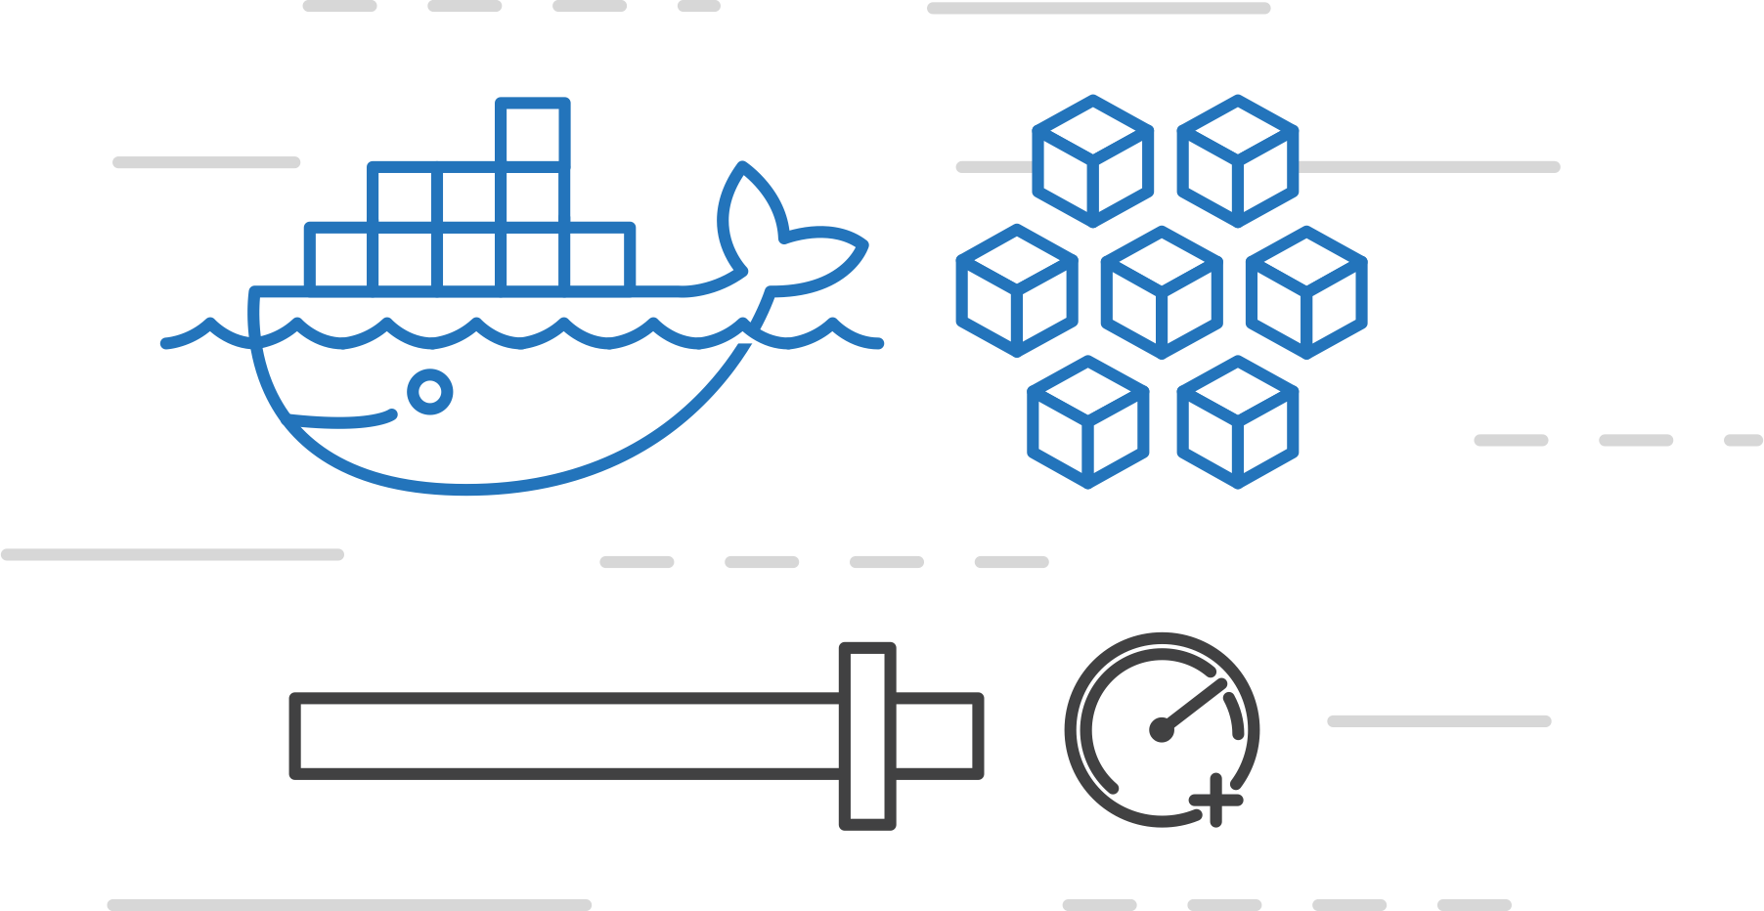
Azure Container Instances (ACI)
Azure Kubernetes Service (AKS)
PREVIEW
Easily run containers on Azure with a single command
Azure Container Instances (ACI)
Azure Container Registry
Open Service Broker API (OSBA)
Start using containers right away
Cloud-scale container capacity
Hyper-visor isolation
Release Automation Tools

Slide 42
Azure Container Instances (ACI)
Azure Kubernetes Service (AKS)
PREVIEW
Get started easily
Azure Container Instances (ACI)
$ az container create --name mycontainer --image microsoft/aci-helloworld --resource-group myResourceGroup --ip-address public
"ipAddress": {
"ip": "52.168.86.133",
"ports": [...]
},
"location": "eastus",
"name": "mycontainer",
"osType": "Linux",
"provisioningState": "Succeeded",
$ curl 52.168.86.133
<html>
<head>
<title>Welcome to Azure Container Instances!</title>
</head>
Azure Container Registry
Open Service Broker API (OSBA)
Release Automation Tools

Slide 43
Azure Container Instances (ACI)
Azure Kubernetes Service (AKS)
PREVIEW
Create an Azure Container Instance quickly
Azure Container Instances (ACI)
Azure Container Registry
Open Service Broker API (OSBA)
Release Automation Tools

Slide 44
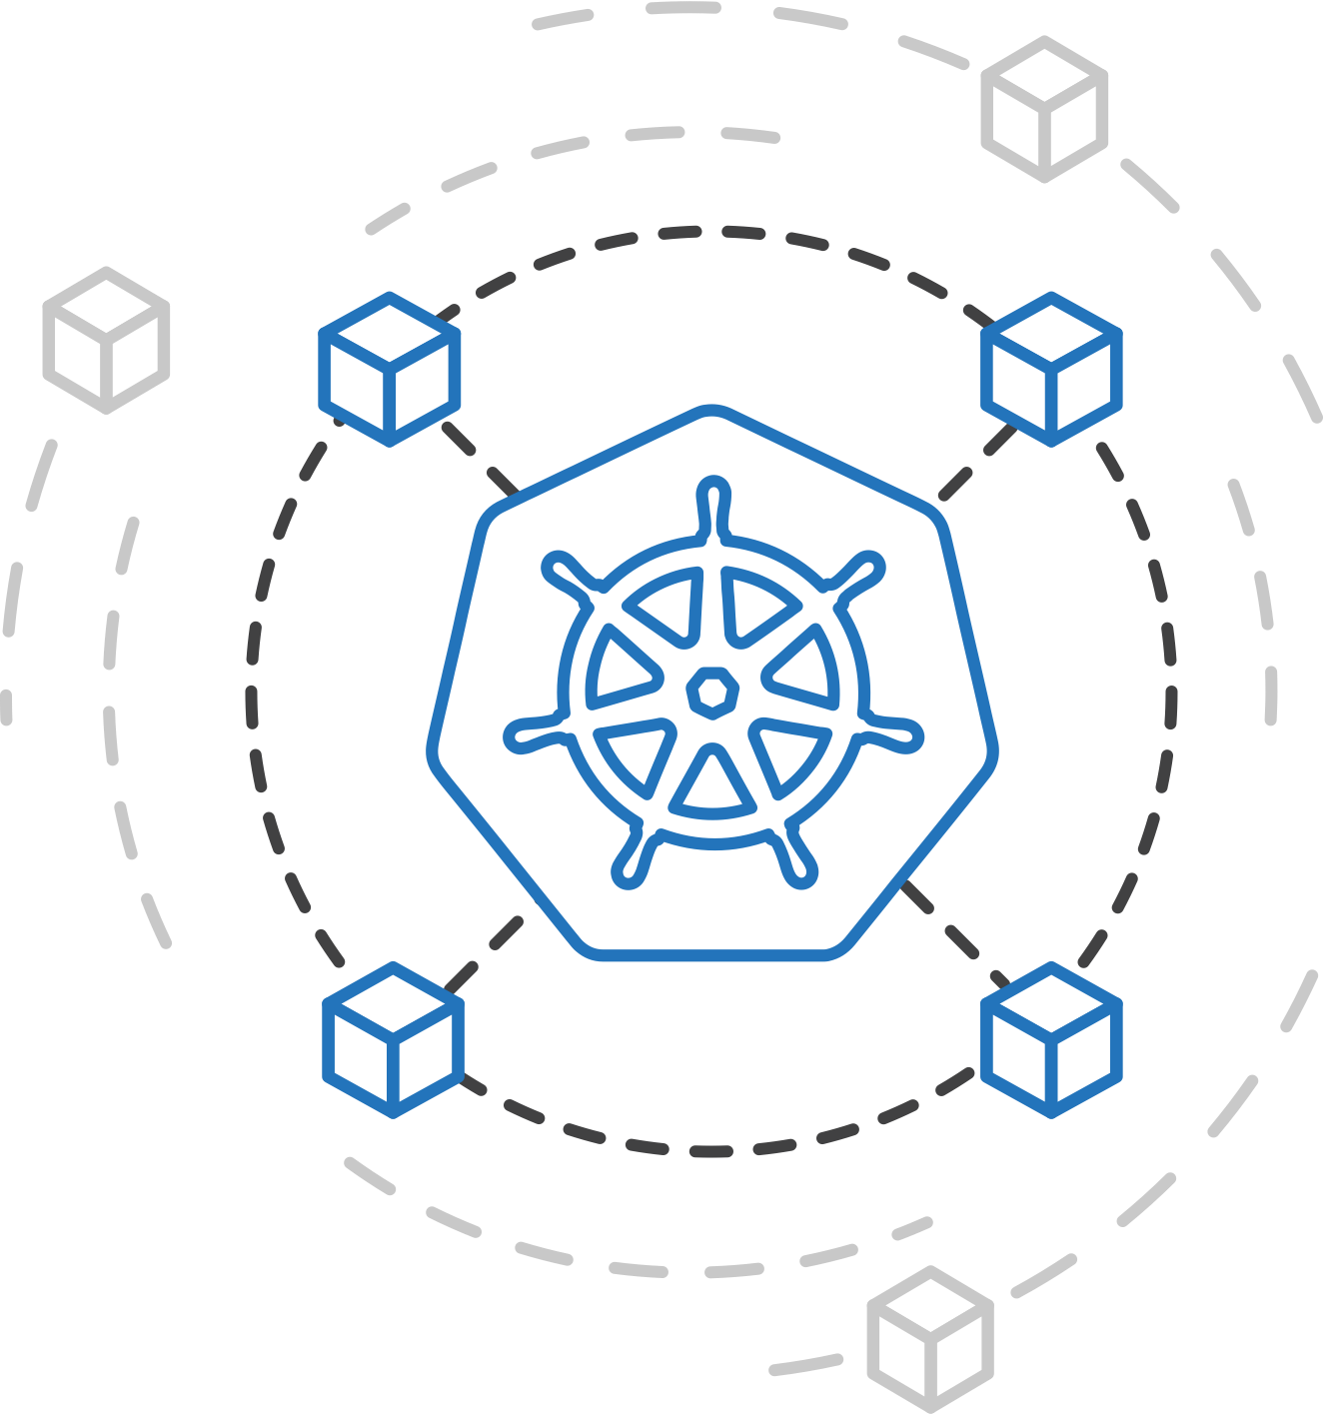
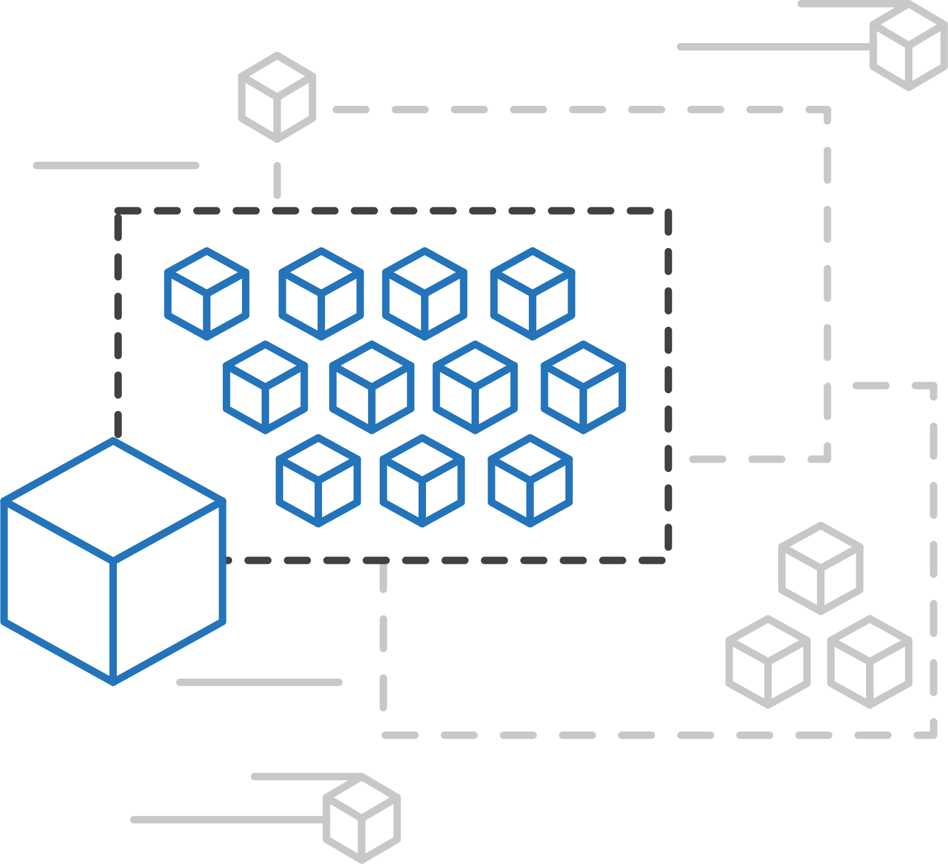
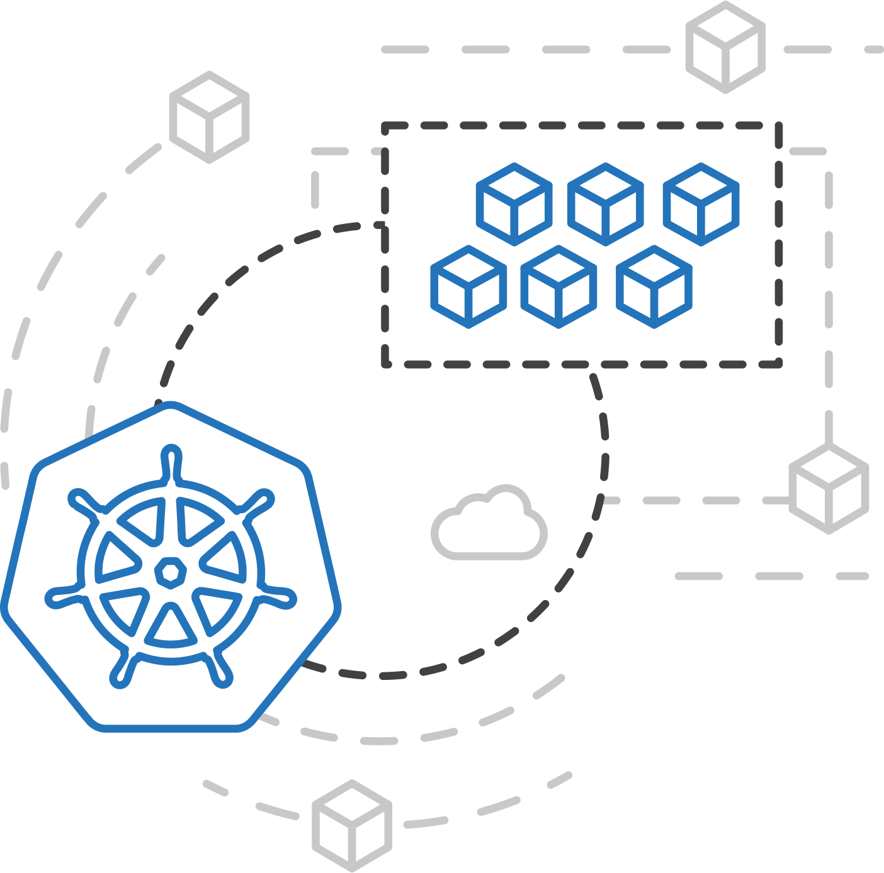
Azure Kubernetes Service (AKS)
Azure Container Instances (ACI)
PREVIEW
ACI Connector for Kubernetes
Azure Container Instances (ACI)
Azure Container Registry
Open Service Broker API (OSBA)
Kubernetes provides rich orchestration capabilities
ACI provides infinite container-based scale
The ACI Connector for K8s brings them together
Release Automation Tools

Slide 45
Azure Container Instances (ACI)
Azure Kubernetes Service (AKS)
PREVIEW
Bursting with the ACI Connector
Azure Container Instances (ACI)
VM
VM
Pod
Waste
Pod
Pod
Pod
Waste
Pod
Pod
Pod
Pod
Azure Container Registry
Azure Container Instances (ACI)
Pod
Pod
Pod
Pod
Pod
Application architect
Kubernetes control pane
ACI Connector
Pod
Pod
Pod
Pod
Pod
Pod
Pod
Pod
Pod
Pod
Open Service Broker API (OSBA)
Pod
Pod
Pod
Pod
Pod
Deployment/ tasks
Pod
Pod
Pod
Pod
Pod
Infrastructure architect
Release Automation Tools
Pod
Waste
Pod
Pod
Pod
Waste
Pod
Pod
Pod
Pod
VM
VM

Slide 46
Azure Kubernetes Service (AKS)
Azure Container Instances (ACI)
PREVIEW
Virtual Kubelet
Azure Container Instances (ACI)
Kubernetes API
Azure Container Registry
Node
Node
Node
Node
virtual kubelet
Kubelet
Kubelet
Kubelet
Kubelet
Open Service Broker API (OSBA)
Release Automation Tools
Typical kubelets implement the pod and container operations for each node as usual.
Virtual kublet registers itself as a “node” and allows developers to program their own behaviors for operations on pods and containers.

Slide 47
Azure Container Registry
Azure Container Registry
Open source community
Azure Kubernetes Service (AKS)
Release automation tools
Containers 101
Getting started
Azure container technology
Open Service Broker for Azure (OSBA)
Customer success stories
Container orchestration
Azure Container Instances (ACI)

Slide 48
Azure Container Registry
Azure Kubernetes Service (AKS)
Azure Container Instances (ACI)
OSBA
App Service
Azure Container Registry (ACR)
Partner services
Azure services
PaaS
Azure Container Registry
OpenShift
SQL Database
Azure Kubernetes Service (AKS)
Service Fabric
Batch
Pivotal Cloud Foundry
Redis Cache
ACS Engine
Open Service Broker API (OSBA)
Docker Enterprise Edition
CosmosDB
Virtual kubelet
Mesosphere DC/OS
And more!
Azure Container Instances (ACI)
Azure Virtual Machines
Virtual Machine Scale Sets (VMSS)
Release Automation Tools
Azure
IaaS

Slide 49
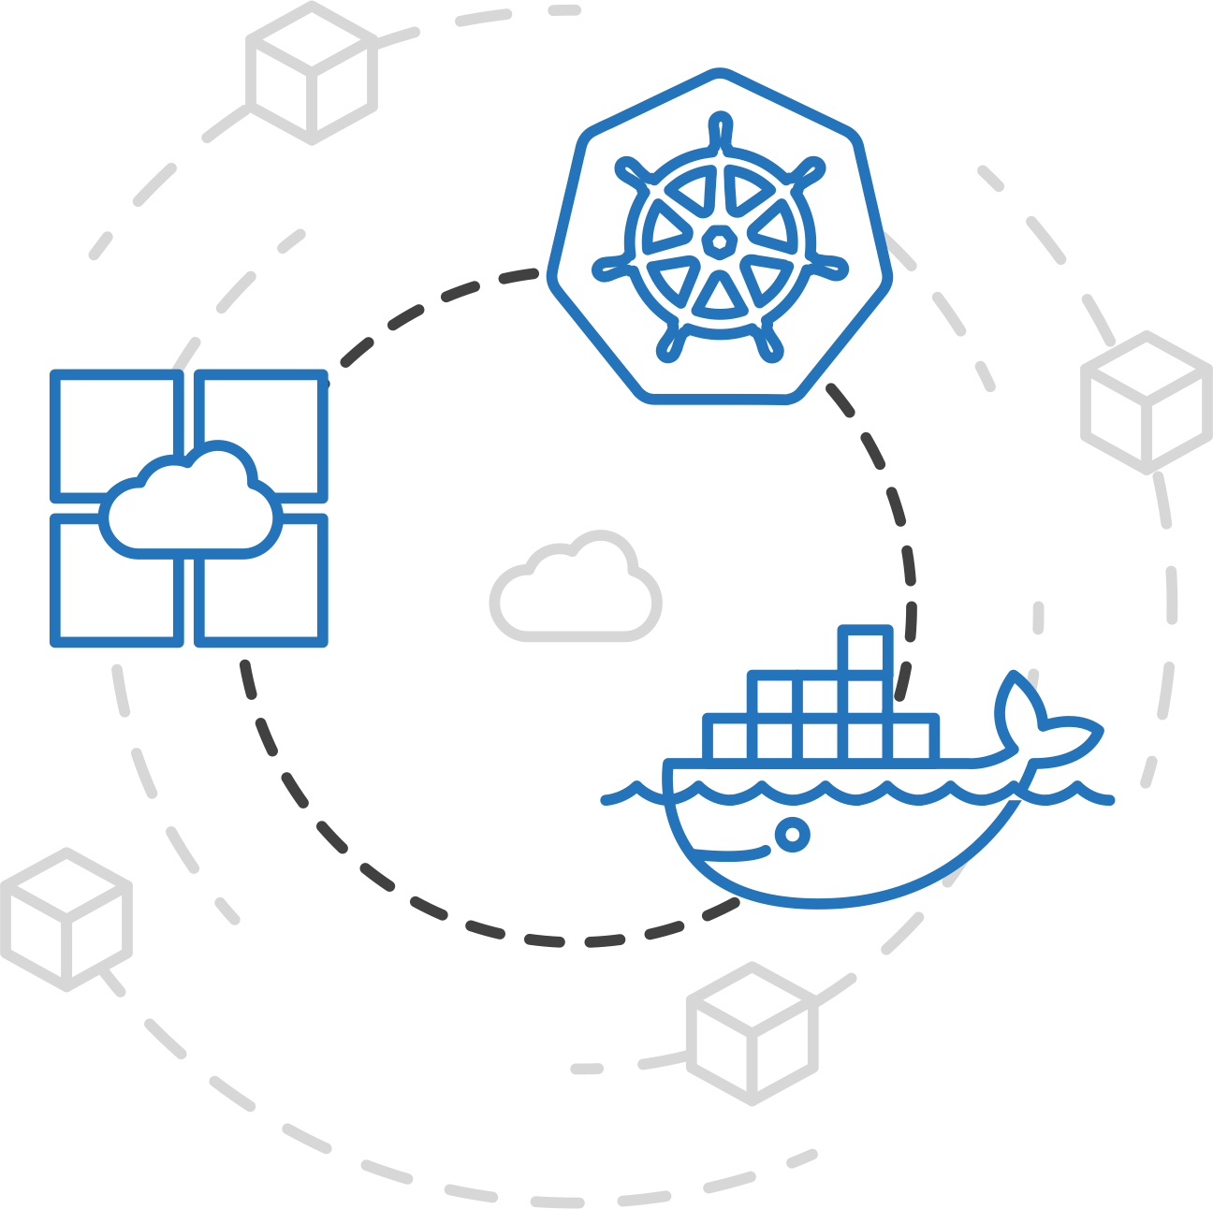
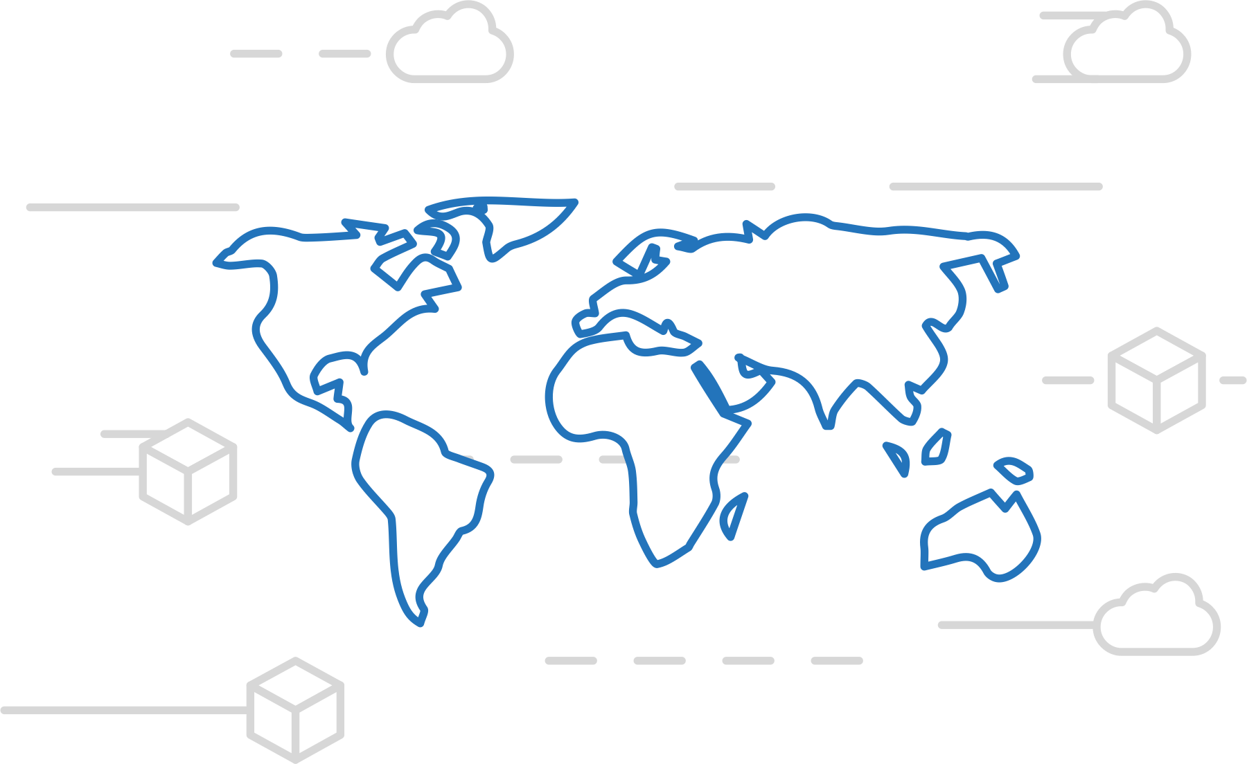
Azure Container Registry
Azure Kubernetes Service (AKS)
Manage a Docker private registry as a first-class Azure resource
Azure Container Instances (ACI)
Azure Container Registry
Open Service Broker API (OSBA)
Manage images for all types of containers
Use familiar, open-source Docker CLI tools
Azure Container Registry geo-replication
Release Automation Tools

Slide 50
Azure Container Registry
Azure Kubernetes Service (AKS)
Create a container in the Registry quickly
Azure Container Instances (ACI)
Azure Container Registry
Open Service Broker API (OSBA)
Release Automation Tools

Slide 51
Kubernetes Concepts

Slide 52
Kubernetes Architecture Components
api-server
etcd
master components
controller-manager
scheduler
* Azure Managed
kubelet
kube-proxy
node components
docker
dns

Slide 53




Pod

Slide 54
pod
pod
rating-api
rating-web
port
3000
port
8080
pod
rating-db
port
27017

Slide 55
Deployment
label
app=heroes-web , tier=web
image
azurecr.io/rating-web:v1
pod
heroes-web-1
port
8080
port
pod
heroes-web-2
port
8080
heroes-web

Slide 56
Deployment
label
app=heroes-web, tier=web
image
azurecr.io/rating-web:v1
pod
Service
heroes-web-1
port
8080
Heroes-web
pod
port
selector
app=heroes-web
heroes-web-2
port
8080:8080
port
8080
IP
10.0.2.20
heroes-web

Slide 57
apiVersion: apps/
Kind: deployment
Metadata:
name: rating-web
apiVersion: apps/
Kind: deployment
Metadata:
name: rating-web
apiVersion: apps/
Kind: deployment
Metadata:
name: rating-web
customResorce
micro-web
api-server
port
8000
deployment
service
ingress
rating-web
rating-web
rating-web
port
8080
port
8080
port
8080
pod
pod
rating-web
rating-web
port
8080
port
8080

Slide 58

Open Service Broker for Azure
Azure Container Registry
Open source community
Azure Kubernetes Service (AKS)
Release automation tools
Containers 101
Getting started
Azure container technology
Open Service Broker for Azure (OSBA)
Customer success stories
Container orchestration
Azure Container Instances (ACI)

Slide 59

Open Service Broker for Azure (OSBA)
Azure Kubernetes Service (AKS)
Azure Container Instances (ACI)
OSBA
App Service
Azure Container Registry (ACR)
Partner services
Azure services
PaaS
Azure Container Registry
OpenShift
SQL Database
Azure Kubernetes Service (AKS)
Service Fabric
Batch
Pivotal Cloud Foundry
Redis Cache
ACS Engine
Open Service Broker API (OSBA)
Docker Enterprise Edition
CosmosDB
Virtual kubelet
Mesosphere DC/OS
And more!
Azure Container Instances (ACI)
Azure Virtual Machines
Virtual Machine Scale Sets (VMSS)
Release Automation Tools
Azure
IaaS

Slide 60
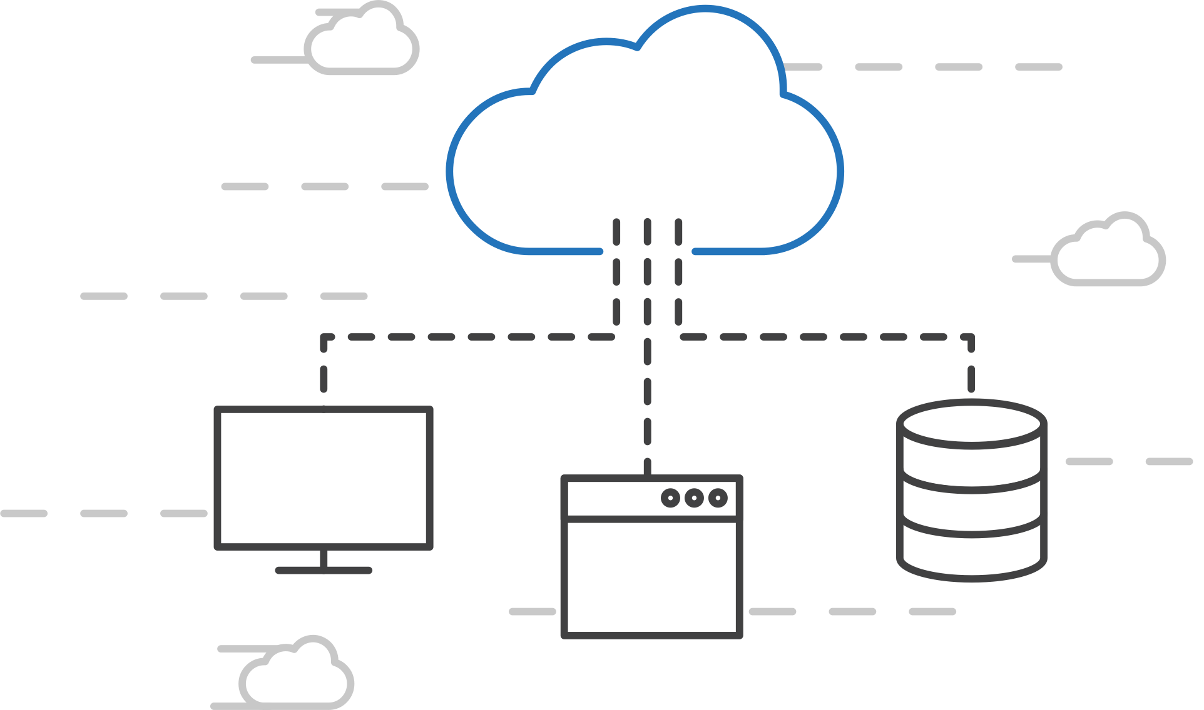
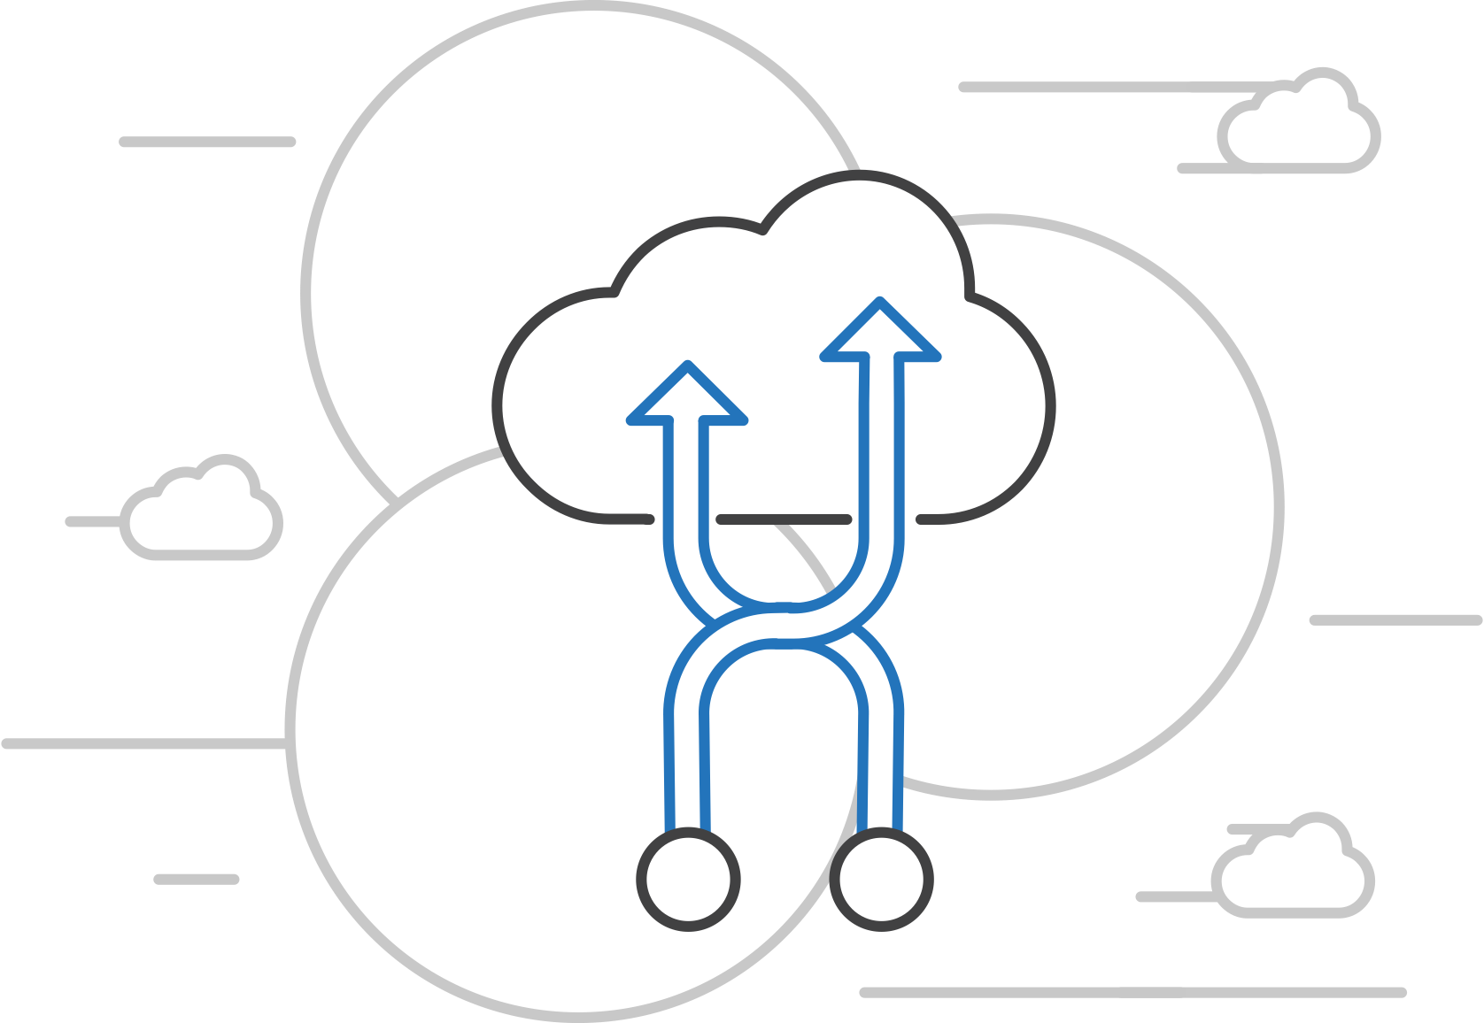
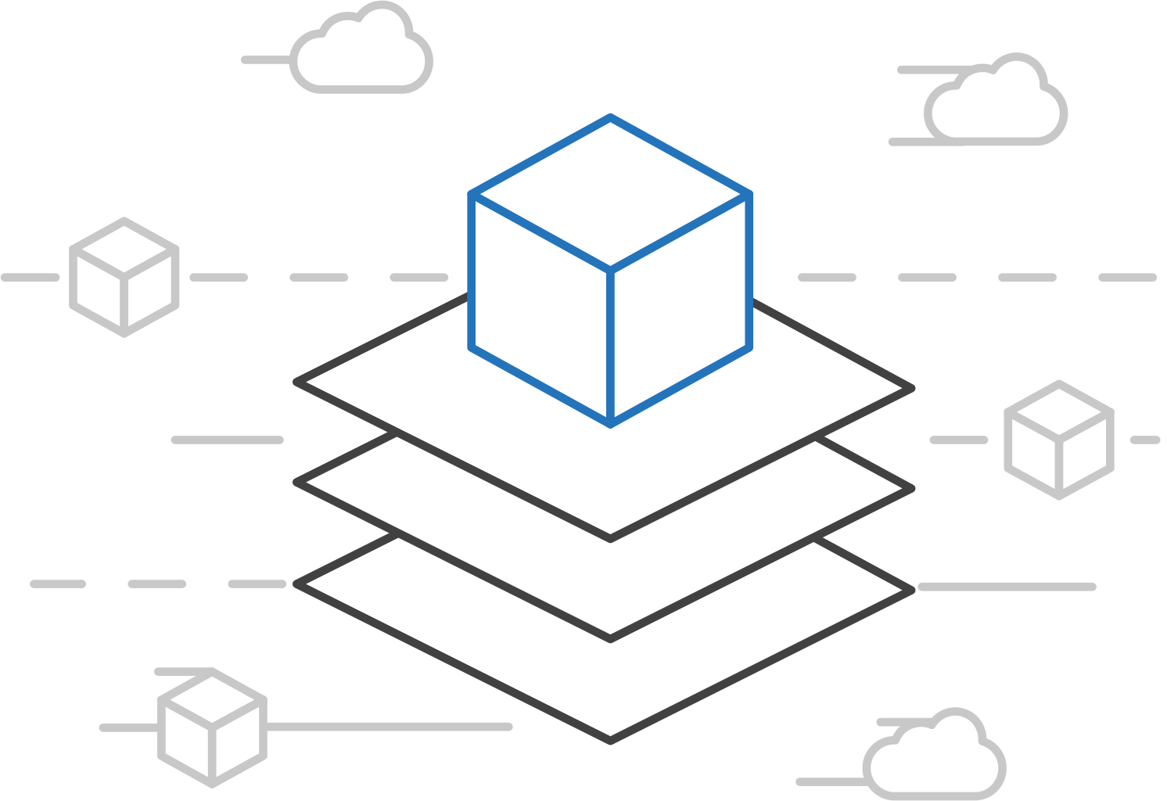
Open Service Broker for Azure (OSBA)
Azure Kubernetes Service (AKS)
Connecting containers to Azure services and platforms
Azure Container Instances (ACI)
Azure Container Registry
Open Service Broker API (OSBA)
A standardized way to connect with Azure services
Simple and flexible service integration
Compatible across numerous platforms
Release Automation Tools

Slide 61
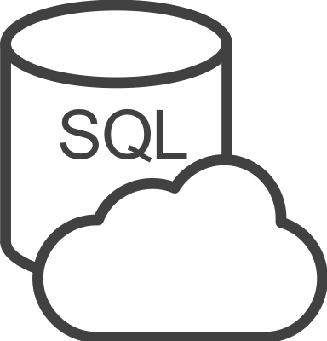






Open Service Broker for Azure (OSBA)
Azure Kubernetes Service (AKS)
An implementation of the Open Service Broker API
Azure Container Instances (ACI)
Azure SQL Database
Redis Cache
CosmosDB
And more!
Azure Container Registry
Open Service Broker for Azure (OSBA)
Open Service Broker API (OSBA)
Release Automation Tools
OpenShift
Cloud Foundry
Service Fabric (Coming soon)
Kubernetes (AKS)

Slide 62

Questions?
Bruno Medina
Bolanos Cacho
SR Software Developer Engineer
Commercial Software Engineering (CSE)
@brusmx

Slide 63
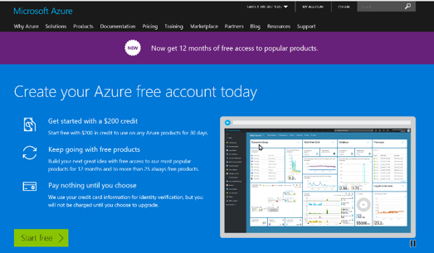
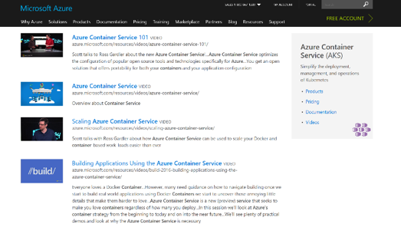
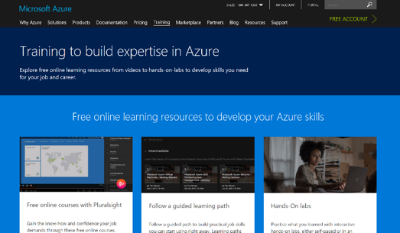
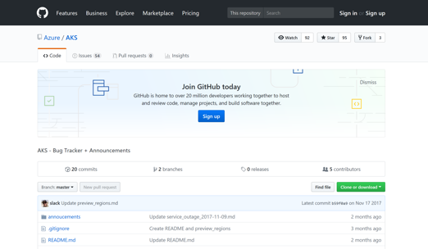
Azure container resources
Azure Kubernetes Service (AKS)
Azure Container Instances (ACI)
Azure Container Registry
OSBA announcement blog
Draft webpage
Helm webpage
Brigade webpage
Kashti announcement blog
Sign up for a free Azure account
Check out the Azure container videos page
Hone your skills with Azure training
Get the code from GitHub

Slide 64
Managing Storage and State

Slide 65

Managing State For Containers
Azure
Data Service
Local Storage
Remote Storage
Pod
Pod
Pod
CosmosDB

Slide 66
Scaling Applications

Slide 67
Application Scaling Strategies
Infrastructure Level
Increase/decrease the number of VM’s running in the cluster
Azure infrastructure function
via AKS API/CLI (utilizes Azure Availability Sets)
Auto-scaling coming to AKS soon
Application Level
Increase/decrease the number of pods for a given service
Handled by the orchestrator or the application itself
Kubernetes Horizontal Pod Autoscaling
These functions should be coordinated

Slide 68
Scaling Pods
Pod
Pod
Pod
Pod
Pod
Pod

Slide 69
Scaling Host
Pod
Pod
Pod
Pod
Pod
Pod
Pod
Pod

Slide 70
Scaling the ACS Cluster

Slide 71
Monitoring

Slide 72
Current monitoring is static in nature

Slide 73
Need to monitor for dynamic environments
Pod
Pod
Pod
Pod
Pod
Pod
Pod
Pod
Pod
Pod
Pod
Pod
Pod
Pod
Pod
Pod

Slide 74
Application Health and Readiness
Kubelets on workers use liveness and readiness probes to know when to restart a container or start directing traffic
Liveness check: when to restart
Readiness check: when to forward Service traffic to a pod
Notes:
Look at liveness
Look at readiness

Slide 75
Monitoring: What indicators matter in Kubernetes
Cluster health: total number of nodes, pods, etc
Node health: available compute resources, health
Application health
Tooling Examples
Datadog
Prometheus
InfluxData
Cloud-specific: OMS (Azure), CloudWatch (AWS)
Notes:
https://docs.datadoghq.com/integrations/kubernetes/

Slide 76
Logging
Pod logs: applications must log to standard out!
Cluster-wide event logs
Logging forwarder solutions
fluentd
logstash
Log indexers
OMS Log Analytics
Splunk
ELK stack

